Slide 1


Team Aasritha Bhimisetty Divya Mahesha Sowmya Kollipara Spandana Atagalla
AERO INSIGHT

Slide 2
Introduction
Planning air travel involves uncertainty in ticket pricing, leading to difficulty in budgeting and decision-making for travellers.
This project aims to build a machine-learning model that predicts flight ticket prices depending on different variables that possibly impact the fare.
Our approach is to utilize historical flight data and machine learning algorithms to predict future prices and Identify key determinants impacting flight costs.

Slide 3
Data Collection
Source: Kaggle.com, obtained from the "Ease my Trip" website.
Data Description:
-Variables: The dataset includes various features such as Airline, departure/arrival city, route, number of stops, duration, departure/arrival time, etc.
-Data Types: All input variables mentioned above are of object data type in the source data.
-Target Variable: The target variable is "price", with a data type of int64.
This comprehensive dataset from Ease My Trip provides a rich source of information for our predictive modeling project, allowing us to explore the relationships between various flight parameters and ticket prices.

Slide 4
Pre-processing
Data Cleaning and Preprocessing:
1. Handling Missing Values and Duplicates:
- Rows containing missing values were dropped using Pandas to ensure data completeness.
- Duplicate rows were identified and removed, retaining only the first occurrence.
2. Outliers:
- Outliers in the "price" feature were identified and replaced with median values, ensuring robustness in the dataset.
3. Handling Categorical Data:
- Nominal categorical data columns were processed using "one-hot encoding", allowing for efficient handling of non-ordinal categorical variables.
- Ordinal categorical data columns were transformed using "label encoding", facilitating numerical representation while preserving the ordinal relationship between categories.

Slide 5
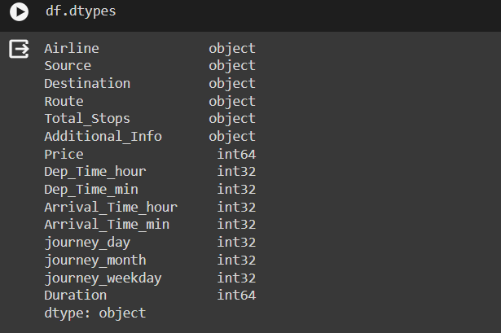
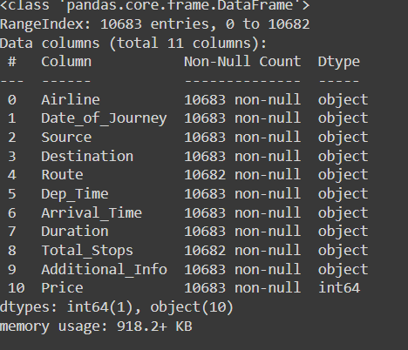
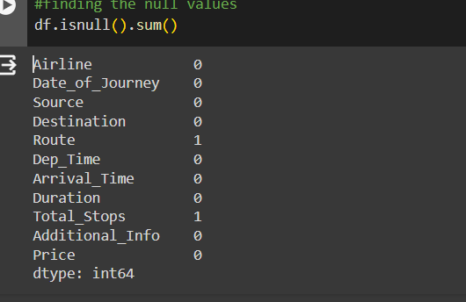

Slide 6
Data Exploration
Python libraries Matplotlib and Seaborn were instrumental in exploring data distributions, correlations, and trends.
Key Observations:
Jet Airways Dominates: Jet Airways emerges with the highest median price among airlines.
Price Escalation with Stops: A clear trend is observed where the median price of flights increases with an increase in the number of stops.

Slide 7
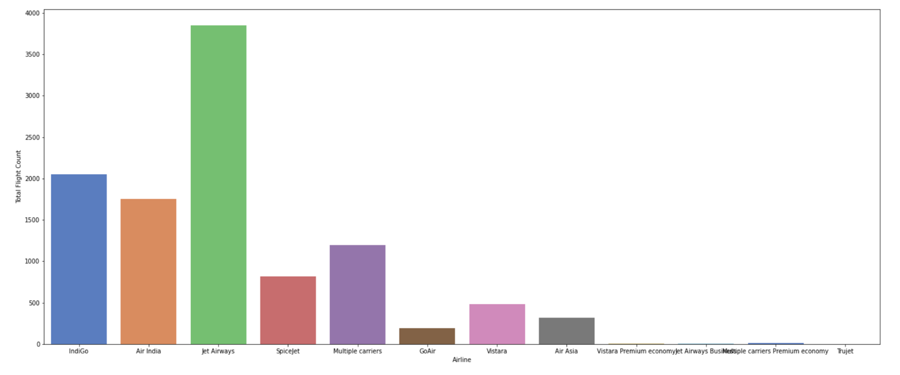
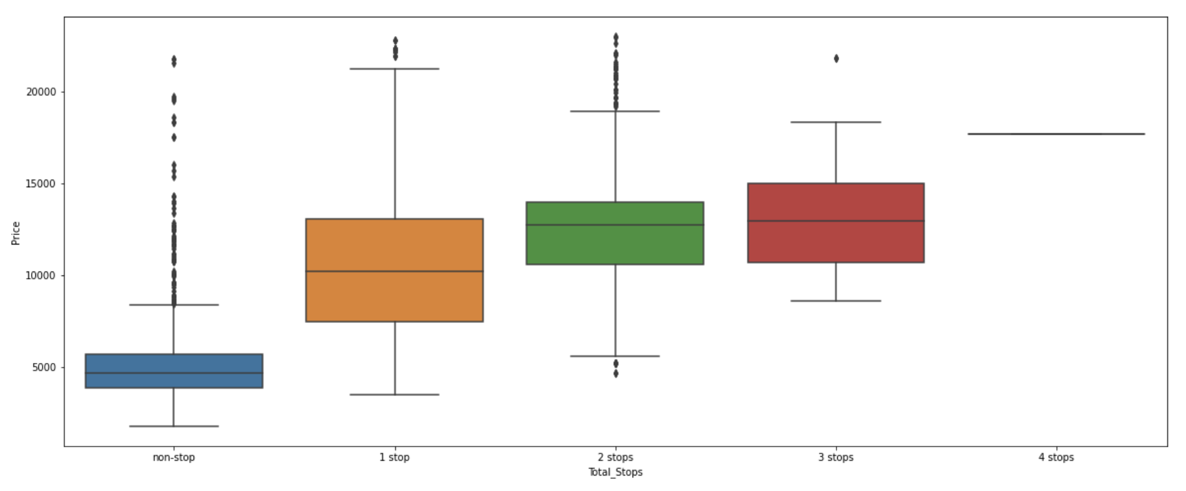
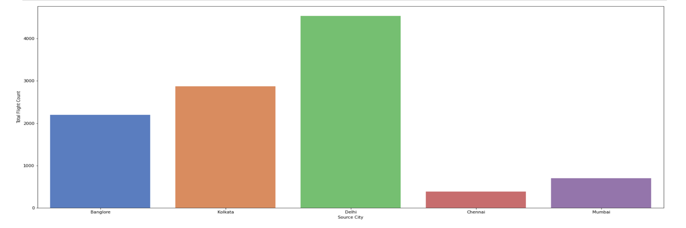
Plot 1: Indicates the Total flight counts for each of the airlines
Plot2: Shows the boxplot of total stops versus price of a flight ticket
Plot3: shows total flights count/ frequency depending on the departure city

Slide 8
Feature selection
Identified features strongly correlated with the independent variable "price" to address dimensionality issues and improve model performance.
Employed the `mutual_info_classif` function from sklearn to analyze the dependency of feature variables on "price".
Utilized the seaborn library to generate a heatmap, visually illustrating the correlation between variables.
Enhanced model efficiency by focusing on features with significant relationships to flight prices.
Reduced dimensionality while preserving predictive power, ensuring optimized model performance in predicting flight ticket prices.

Slide 9
Model Selection and Training
Utilized train_test_split from sklearn to partition the dataset into training and testing subsets.
Experimented with multiple machine learning algorithms to evaluate their performance on the data.
Performance Metrics: R2-score, MAE (Mean Absolute Error), MSE (Mean Squared Error), and RMSE (Root Mean Squared Error) were used to validate and compare the models.
Algorithms Explored:
Logistic Regression
KNN (K-Nearest Neighbors)
Decision Tree Regressor
Gradient Boosting Regressor
Random Forest Regressor
This comprehensive evaluation process allowed us to identify the most effective algorithm for predicting flight ticket prices with high accuracy and reliability.

Slide 10
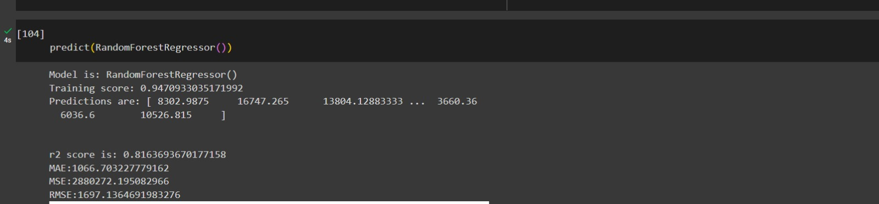
Result

Slide 11
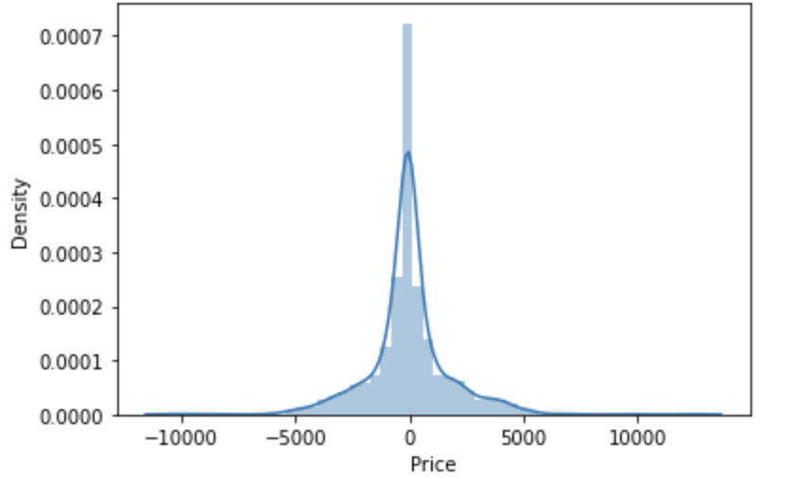
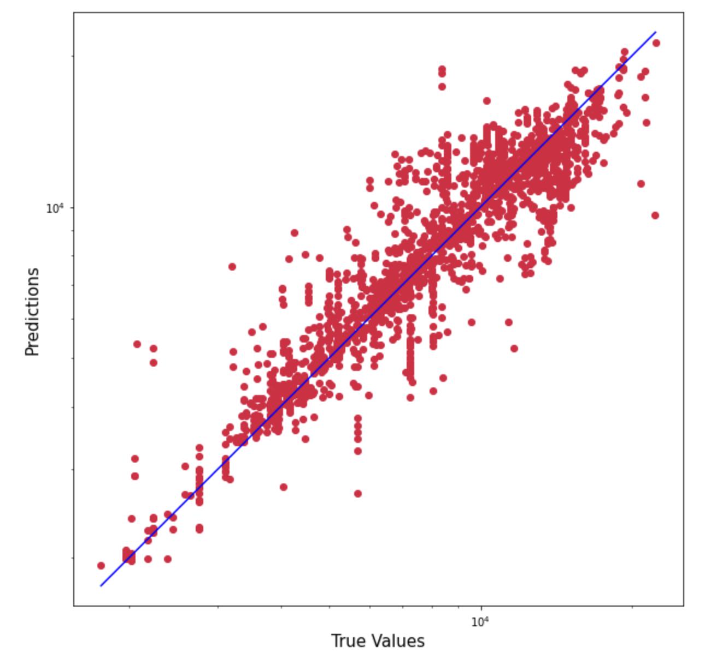
Plot 4: shows the probability distribution of actual error in test-data i.e. the difference between predicted values and true values of test data
Plot 5: A scatter plot between the true values and predicted values of test data. The closer the dots to the line the less is the difference between predicted and true price values indicating more accurate is the predicted value.

Slide 12
Insights and Findings
Findings on how different flight routes, layover durations, or specific airlines influence variations in pricing.
Identification of the most effective machine learning algorithms or regression techniques for predicting flight prices.
Insights into the overall precision and dependability of the predictive models in estimating flight ticket prices.

Slide 13
Conclusion
Future Scope and Findings
Incorporating economic indicators such as fuel prices, exchange rates, or GDP into the analysis to understand their potential impact on ticket prices.
Exploring the use of deep learning models to capture nonlinear patterns within the dataset.
Experiment with advanced ensemble models or stacking techniques that combine multiple algorithms to enhance prediction accuracy.
Integrating weather data, including temperature and precipitation at departure and arrival locations, to assess its influence on pricing dynamics.
Transitioning the project to a cloud-based infrastructure for enhanced scalability, enabling the handling of larger datasets and greater computational capabilities.

Slide 14
THANK YOU

